Slide 1
Church Readings
Deacons Meeting
By HG Bishop Abraham

Slide 2
Introduction
The daily readings in the church year are not randomly put together
They have been intelligently arranged according to the commemoration of the day
The readings are found in a book called the katameroc (“katameros”)
kata (“kata”) = according
meroc (“meros”) = part

Slide 3
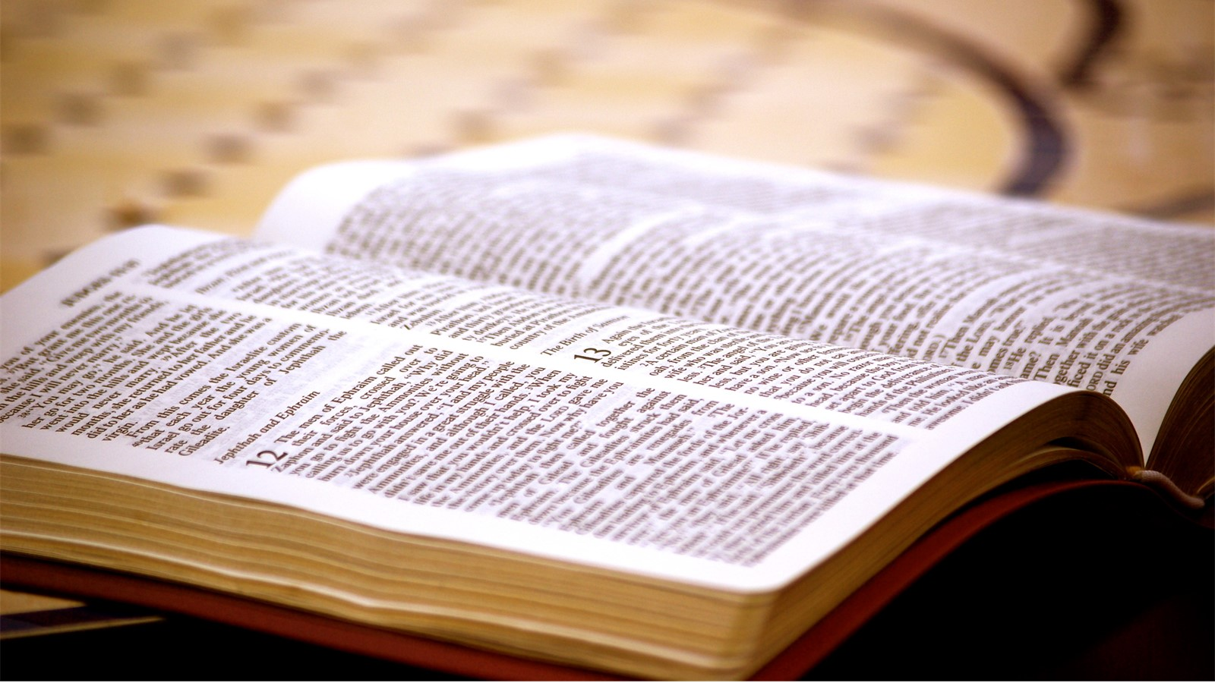
Katameroc
Mangalia
(Ma-ngelia)
“Place of the Gospel”

Slide 4
Katameroc – How many Katameroc are there?
1
Standard Sundays
2
English word for these books is “lectionary”
Standard Weekdays
3
Great Fast
4
Pascha
5
Pentecost (Holy Fifty Days)

Slide 5
Coptic Months
Pronounced | Arabic | Gregorian Calendar | Event
Thoout | Tout | Sept 11/12 – Oct 9/10 | Nayrouz
Paope | Babah | Oct 11/12 – Nov 9/10
Hathor | Hatour | Nov 10/11 – Dec 9/10
Koiahk | Kiahk | Dec 10/11 – Jan 8/9 | Nativity Fast
Tobe | Tubah | Jan 9/10 – Feb 7/8 | Nativity, Theoph.
Meshir | Amshir | Feb 8/9 – Mar 9 | Great Fast
Paremhotep | Baramhat | Mar 10 – April 8 | Great Fast
Parmoute | Baramoudah | April 9 – May 8 | Great Fast
Pashons | Bashans | May 9 – June 7 | Great Fast/Pent.
Paone | Baounah | June 8 – July 7 | Pent./Apost.Fast
Epep | Abib | July 8 – Aug 6
Mesore | Misra | Aug 7 – Sept 5 | St. Mary’s Fast
Pi-koji en-a-vot | Al-Nasi | Sept 6 - 10

Slide 6
Standard Sunday Readings
Four Sundays from each of the following 9 Months:
Tout, Babah, Hatour, Kiahk, Tubah, Amshir, Baounah, Abib, Misra (36 Sunday readings)
The two last Sundays from the month of Bashans
A total of 40 Standard Sunday Readings:
One Sunday from the Little Month
The fifth Sunday of any month
All Sundays of Baramhat, Baramoudah, and the first two Sundays of Bashans are included in the Great Lent, Pascha Week, and Pentecost Lectionaries

Slide 7
Standard Sunday Readings
All 40 Sundays discuss a single subject: “The work of the Holy Trinity”
This subject is divided into three main parts:
The love of God the Father to mankind
The grace of the only-begotten Son, Jesus Christ, to His people
The communion and gift of the Holy Spirit

Slide 8
Standard Sunday Readings
EXAMPLES
1
“The love of God the Father to mankind:”All the readings of Tout Sundays
“The grace of the only-begotten Son, Jesus Christ, to His people:”All the readings on the Sundays from Babah to Bashans
2

Slide 9
“The grace of the only-begotten Son, Jesus Christ to His people:”
EXAMPLES
Babah: The power of the only-begotten Son, Jesus Christ, on the souls
Kiahk: The appearance of the only-begotten Son, Jesus Christ, among His people
Hatour: The gospel of the only-begotten Son, Jesus Christ, to His people
Tubah: The salvation of the only-begotten Son, Jesus Christ, to the Gentiles

Slide 10
“The grace of the only-begotten Son, Jesus Christ to His people:”
EXAMPLES
Bashans: The dominance of the only-begotten Son, Jesus Christ, over His people
Amshir: The spiritual food of the only-begotten Son, Jesus Christ, to His people

Slide 11
The Rest
3
“The communion and gift of the Holy Spirit:” All the readings of Baounah Sundays
4
“The help of the Savior to His Apostles:” All the readings of Abib Sundays
5
“The Savior’s care for His church:” All the readings of Mesra Sundays
6
“The Second Coming of the Lord Jesus Christ and the End Times:” All the readings of the Little Month Sunday

Slide 12
Fifth Sunday
If any of the above months has a fifth Sunday, it is an extra week or a blessing
So, we read about the miracle of the five loaves and the two fish
The Fifth Sunday in the first 6 month of the year from Tout to Amshir we read the second Sunday of the month of Amshir
The Fifth Sunday of the rest of the year from Baramhat to Mesra we read the Fifth Sunday readings in the book of Katameros part of Sunday readings.
If any Feasts of the Lord fall on one of these Sundays, we read from the readings of the feast and not that Sunday’s reading

Slide 13
Effect of the Resurrection Date
The date of the Resurrection affects not only the church calendar, but also the timing of the church readings.
When the Resurrection is early:
Jonah’s Fast is early
Beginning of the Great Fast is early
Feast of the Pentecost is early
Apostle’s Fast starts early: always ends on July 12

Slide 14
Feasts and Weekday Readings
We have covered the 40 standard Sundays of the year
We still have the readings for the feast days of the Lord and, also, the martyrs and saints

Slide 15
The Holy Feasts of the Church
I. The Coptic New Year
II. The Head of the Church
Feasts of the Lord
Annunciation | Circumcision
Nativity | Entry into the Temple
Theophany | Flight to Egypt
Palm Sunday | Wedding of Cana of Galilee
Resurrection | Covenant Thursday
Ascension | Thomas Sunday
Pentecost | Transfiguration
B. Feasts of the Cross
C. Resurrection Feast

Slide 16
The Holy Feasts of the Church
The Body of the Church
The Mother of God
The Angels
John the Baptist
The Children of Bethlehem
The Three Fathers: Abraham, Isaac, and Jacob
The Prophets and Innocents
The Preachers
The Twelve Disciples
The Seventy Apostles
The
Evangelists

Slide 17
The Holy Feasts of the Church
H. The Martyrs
I. The Fathers of the Church
i. The Patriarchs
ii. The Bishops

Slide 18
Weekday Reading Rules
Gospel and Pauline touch on the same subject
Vespers and Matins Gospels complement liturgy Gospel
Catholic Epistle and Acts complement the Pauline
All the weekday readings are based on the feast days and commemorations of the martyrs and saints of that day
The Synaxarion, then, determines what the readings are for the weekdays
Remember, Sunday readings have their own arrangement

Slide 19
Weekday Reading Rules
If there are multiple saints on any given day (happens almost always), the church picks a main saint upon whom to base the readings
So, the church picks on of the Saints of the Day.
What are “borrowed days”?

Slide 20
Borrowed Days
The entire weekday reading selections for the whole year are based on the selections of only 69 days
Have you ever looked at the weekday katameroc before?
You will find that it has readings on some days, but on other days, it directs us to the readings of another day!

Slide 21
Borrowed Days: Example
Consider the 22nd of Tubah
What feast day is it?
The Feast of St. Anthony is considered one of the “special days”
St. Anthony is the father of monks, so there are other saint feast days in which it would be appropriate to “borrow” from the readings of St. Anthony’s feast day

Slide 22
Borrowed Days: Example
St. Illarion the monk: 24th of Babah
St. Poemen the confessor and monk: 9th of Kiahk
St. Isaac the priest of the cells: 19th of Bashans
St. Abanoub the confessor and monk: 23rd of Baounah
The same applies to all other “groups”

Slide 23
Borrowed Days: Example
Tubah 22
Pauline: Hebrews 11:32-12:2
33 who through faith subdued kingdoms, worked righteousness, obtained promises, stopped the mouths of lions,
34 quenched the violence of fire, escaped the edge of the sword, out of weakness were made strong, became valiant in battle, turned to flight the armies of the aliens.

Slide 24
Borrowed Days: Example
37 They were stoned, they were sawn in two, were tempted, were slain with the sword. They wandered about in sheepskins and goatskins, being destitute, afflicted, tormented ---
38 of whom the world was not worthy. They wandered in deserts and mountains, in dens and caves of the earth.

Slide 25
Borrowed Days: Example
Catholic Epistle: James 5:9-20
10 My brethren, take the prophets, who spoke in the name of the Lord, as an example of suffering and patience.
11 Indeed we count them blessed who endure. You have heard of the perseverance of Job and seen the end intended by the Lord --- that the Lord is very compassionate and merciful.

Slide 26
Borrowed Days: Example
Acts 11:19-26
23 When he came and had seen the grace of God, he was glad, and encouraged them all that with purpose of heart they should continue with the Lord.
24 For he was a good man, full of the Holy Spirit and of faith. And a great many people were added to the Lord.

Slide 27
Borrowed Days: Example
Gospel: Luke 12:32-44
32 Do not fear, little flock, for it is your Father's good pleasure to give you the kingdom.
33 Sell what you have and give alms; provide yourselves money bags which do not grow old, a treasure in the heavens that does not fail, where no thief approaches nor moth destroys.
34 For where your treasure is, there your heart will be also.

Slide 28
Borrowed Days: Example
42 And the Lord said, "Who then is that faithful and wise steward, whom his master will make ruler over his household, to give them their portion of food in due season?
43 Blessed is that servant whom his master will find so doing when he comes.
44 Truly, I say to you that he will make him ruler over all that he has.

Slide 29
Most Used Day
Hatour 28: Total of 26 times
“Group”: A martyred bishop
Liturgy Gospel
John 16:20-33
20 Most assuredly, I say to you that you will weep and lament, but the world will rejoice; and you will be sorrowful, but your sorrow will be turned into joy.
21 A woman, when she is in labor, has sorrow because her hour has come; but as soon as she has given birth to the child, she no longer remembers the anguish, for joy that a human being has been born into the world.

Slide 30
Most Used Day
22 Therefore you now have sorrow; but I will see you again and your heart will rejoice, and your joy no one will take from you.
23 "And in that day you will ask Me nothing. Most assuredly, I say to you, whatever you ask the Father in My name He will give you.
24 Until now you have asked nothing in My name. Ask, and you will receive, that your joy may be full.

Slide 31
Most Used Day
25 "These things I have spoken to you in figurative language; but the time is coming when I will no longer speak to you in figurative language, but I will tell you plainly about the Father.
26 In that day you will ask in My name, and I do not say to you that I shall pray the Father for you;
27 for the Father Himself loves you, because you have loved Me, and have believed that I came forth from God.

Slide 32
Most Used Day
28 I came forth from the Father and have come into the world. Again, I leave the world and go to the Father."
29 His disciples said to Him, "See, now You are speaking plainly, and using no figure of speech!
30 Now we are sure that You know all things, and have no need that anyone should question You. By this we believe that You came forth from God."
31 Jesus answered them, "Do you now believe?

Slide 33
Most Used Day
32 Indeed the hour is coming, yes, has now come, that you will be scattered, each to his own, and will leave Me alone. And yet I am not alone, because the Father is with Me.
33 These things I have spoken to you, that in Me you may have peace. In the world you will have tribulation; but be of good cheer, I have overcome the world."

Slide 34
Month of Tout:
Notes on the readings:
The readings of the 1st of Tout (Feast of the Nayrouz) will be read if it comes on Sunday or any other weekday for the month of Tout but will still include four Sundays even if the Nayrouz feast comes on Sunday.
1
If the Feasts of the Cross ( or the 2nd/3rd day of the Feast of the Cross) come on Sunday. The readings for the feast are read instead of the Sunday readings.
2
3
The Feasts of the Cross (17 Tout) is treated as one of the major feasts of the Lord. The prayers are all chanted in the Palm Sunday (Sha’aniny) and the joyful tunes and is celebrated for 3 days.

Slide 35
Month of Kiahk:
Notes on the readings:
1
If the month of Kiahk doesn’t have four weeks before the Paramony of the Nativity, the last Sunday of the month of Hathor to be considered as the first Sunday of the month of Kiahk.
2
If the Paramony of the Nativity was more than one day, it is necessary to repeat the readings of the Paramony during these days, even if it comes on a Sunday.
If the Feast of the Nativity happened to be on the 28th of Kiahk, the readings of the 29th of Kiahk are read during the feast, since the 29th of Kiahk is the original feast day. In addition, the readings are repeated again on the 29th of Kiahk, even if it comes on a Sunday. As for the 27th of Kiahk, if the Paramony happened to be on that day, the readings of the 28th of Kiahk are read on that day, as per the following table:
3
Day | Reading
January 6 - 27th of Kiahk - Paramony | The readings of the 28th of Kiahk are read
January 7 - 28th of Kiahk - Feast | The readings of the 29th of Kiahk are read
January 8 - 29th of Kiahk | The readings of the 29th of Kiahk are read
January 9 - 30th of Kiahk | The readings of the 30th of Kiahk are read
If the 30th of Kiahk comes on a Sunday, the readings of the 30th of Kiahk are read, and not the readings of the fifth Sunday, since it is repeated and does not suit the following day of the glorious Feast of the Nativity.
4

Slide 36
Month of Tobe:
Notes on the readings:
If the Paramony of the Epiphany is more than one day, the Paramony readings must be repeated, even if one of those days is a Sunday.
1
If the 12th of Tobe (the second day of the Epiphany) is on a Sunday, the readings of the second day of the Epiphany are read instead of second Sunday of Tobe readings.
2
3
If the Feast of the Circumcision or the Feast of the Wedding of Cana of Galilee came on a Sunday, the readings of the Feast is read since they are treated as one of the feasts of the Lord.

Slide 37
Month of Emeshir:
Notes on the readings:
The Feast of our Lord’s Entry into the Temple is celebrated on the 8th day of the month of Emeshir, and it is among the Feasts of the Lord. If the feast cames during the Fast of Nineveh or the Great Lent or a Sunday, the reading of the Feast is read instead.

Slide 38
Month of Baramhat:
Notes on the readings:
1
The Feasts of the Cross (10 Baramhat) is treated as one of the feasts of the Lord.
2
The reading of 17 Tout is read in the Feast of the Cross even if it falls on a Sunday or in the Great Lent.
3
The Feast of the Annunciation (29th of Baramhat)is one of the feasts of the Lord.
The reading of the Feast of the Annunciation is read even if it cames on a Sunday or in the Great Lent.
4

Slide 39
Month of Bashons:
Notes on the readings:
If the Feast of our Lord’s Entry into Egypt (24 Bashons)comes during the Holy 50 days, it is preferred to read the Feast’s reading to the spiritual meaning of the Feast.

Slide 40
Month of Abib:
Notes on the readings:
If the Apostles Feast comes on a Sunday, we read the readings of the Sunday.

Slide 41
Fast of Nineveh:
Notes on the readings:
The readings of the 3 fasting days and the feast are all read from the Lectionary of the Great Lent.

Slide 42
Preparation for the great Lent:
Notes on the readings:
The readings of Pre-Lent Sunday is read from the Lectionary of the Great Lent.

Slide 43
Any Questions

